Slide 1

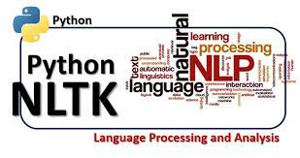
Restaurant Review Analysis

Slide 2
Introduction
Nowadays, people often judge which restaurant is good or bad by looking at the rating of the restaurant. That’s why ratings are a critical factor in the restaurant business. Ratings are usually given by people judging by what kind of service restaurants are providing.
Sentiment analysis is a huge volume increasing at a humongous rate everyday which has made it almost impossible to evaluate the data manually. In Social media, twitter, restaurant site people share their opinion as in a huge number of their prevalence. In order to make the process of analyzing the text automatic there are various machine learning techniques that could be applied.

Slide 3
These ratings are also helpful for the restaurant owners to make changes based on their reviews for improving their business Restaurant reviews contains textual information. But most machine learning algorithms work with numerical data only. Machine learning can be considered one of the applications of artificial intelligence (AI).ML provides a way to learn the systems without being explicitly programmed and this learning can be used for solving problems
For text, processing machine learning provides Natural processing (NLP) capabilities. We can easily analyse our textual datasets through NLP methodologies. NLP provides an opportunity for data analysts to apply machine learning and deep learning algorithms to our textual datasets

Slide 4
Aim of The Project
Normally, a lot of businesses are remained as failures due to lack of profit, lack of proper improvement measures. Mostly, restaurant owners face a lot of difficulties to improve their productivity. This project really helps those who want to increase their productivity, which in turn increases their business profits. This is the main objective of this project.
What the project does is that the restaurant owner gets to know about drawbacks of his restaurant such as most disliked food items of his restaurant by customer’s text review which is processed with ML classification algorithm (Naive Bayes)
The purpose of this analysis is to build a prediction model to predict whether a review on the restaurant is positive or negative

Slide 5
Technologies used
NLTK
Machine Learning
Python
Tkinter
MySQL
Pandas
Matplotlib/seaborn

Slide 6
What is Machine learning ?
Machine learning (ML) is a type of artificial intelligence (AI) that allows software applications to become more accurate at predicting outcomes without being explicitly programmed to do so. Machine learning algorithms use historical data as input to predict new output values
Many of today's leading companies, such as Facebook, Google and Uber, make machine learning a central part of their operations. Machine learning has become a significant competitive differentiator for many companies
The importance of machine learning can be easily understood by its uses cases, Currently, machine learning is used in Stock Market Prediction , Cancer detection system , recommendation system , targeted marketing self-driving cars, cyber fraud detection, face recognition, and friend suggestion by Facebook and many more .

Slide 7
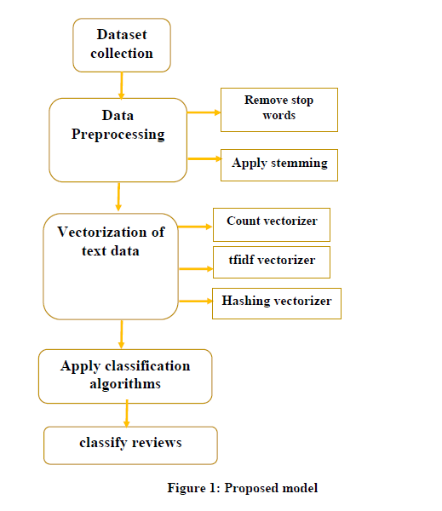
Structure
of
Proposed model

Slide 8
Implementation
Importing necessary packages:
Import Dataset
Cleaning data
Text processing using NLTK
Train Test split
Count Vectorizer
Model training using Naive bays algorithm(MultinomialNB)
Deployment

Slide 9
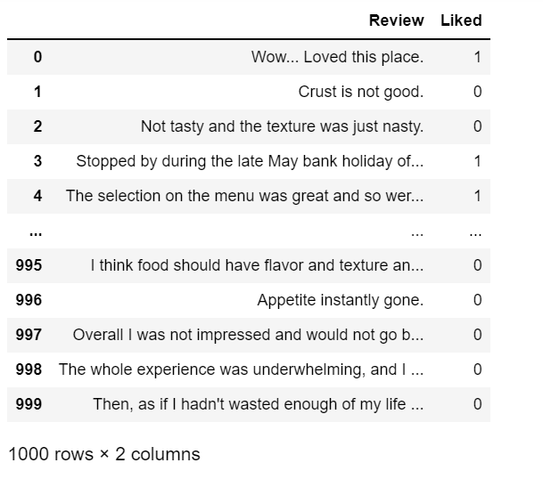
Dataset Description
The dataset is downloaded from superdatascience.com.
The dataset contains reviews in the text format.
It also contains a feature that indicates whether the review is positive or negative.
A positive review can de indicate by 1 and a negative review is indicated by 0.

Slide 10
Text Processing by using NLTK
Natural Language Processing (NLP) is the sub field of computer science especially Artificial Intelligence (AI) that is concerned about enabling computers to understand and process human language
NLTK consists of the most common algorithms such as tokenizing, part-of-speech tagging, stemming, sentiment analysis, topic segmentation, and named entity recognition. NLTK helps the computer to analysis, pre-processes, and understand the written text.

Slide 11
Tokenization
Tokenization is done by natural language toolkit predefined function nltk word_tokenize.
It may be defined as the process of breaking up a piece of text into smaller parts, such as sentences and words. These smaller parts are called tokens
NLTK is a platform for python language, it offers over 50 corpuses and lexical resources for example sentiwordnet3.0, Wordnet etc.
from nltk.tokenize import sent_tokenize, word_tokenize
text = "Natural language processing is an exciting area."
print(sent_tokenize(text))
"Natural” “language” “processing” “is” “an” “exciting area.”

Slide 12
Removing Stop Words
The words which are generally filtered out before processing a natural language are called stop words. These are actually the most common words in any language (like articles, prepositions, pronouns, conjunctions, etc) and does not add much information to the text.
According to standford.edu, some particularly common words, those word’s appearance have little value in favouring select documents matching, a user need are excluded from the vocabulary entirely.

Slide 13
Stemming
Stemming is a technique used to extract the base form of the words by removing affixes from them
In our text we may find many words like playing, played, playfully, etc… which have a root word, play all of these convey the same meaning. So we can just extract the root word and remove the rest. Here the root word formed is called ‘stem’ and it is not necessarily that stem needs to exist and have a meaning. Just by committing the suffix and prefix, we generate the stems.
NLTK provides us with PorterStemmer LancasterStemmer and SnowballStemmer packages
Lovingly lovable loved
stem word >> love

Slide 14
CountVectorizer
CountVectorizer means breaking down a sentence or any text into words by performing pre-processing tasks like converting all words to lowercase, thus removing special characters. In NLP models can't understand textual data they only accept numbers, so this textual data needs to be vectorized
It is used to transform a given text into a vector on the basis of the frequency (count) of each word that occurs in the entire text

Slide 15
Model Training
Naive bays:
Principle of Naive Bayes Classifier:
A Naive Bayes classifier is a probabilistic machine learning model that’s used for classification task. The classifier is based on the Bayes theorem.
When the features are independent, we can extend Bayes’ rule to what is called Naive Bayes which assumes that the features are independent which means changing the value of one feature doesn’t influence the values of other variables and this is why we call this algorithm “NAIVE”
Naive Bayes can be used for various things like face recognition, weather prediction, Medical Diagnosis, News classification, Sentiment Analysis, and a lot more.

Slide 16

The formula for Bayes' theorem is given as:
Where,
P(A|B) is Posterior probability: Probability of hypothesis A on the observed event B.
P(B|A) is Likelihood probability: Probability of the evidence given that the probability of a hypothesis is true.
P(A) Is Prior Probability: Probability of hypothesis before observing the evidence
P(B) is Marginal Probability: Probability of Evidence.

Slide 17
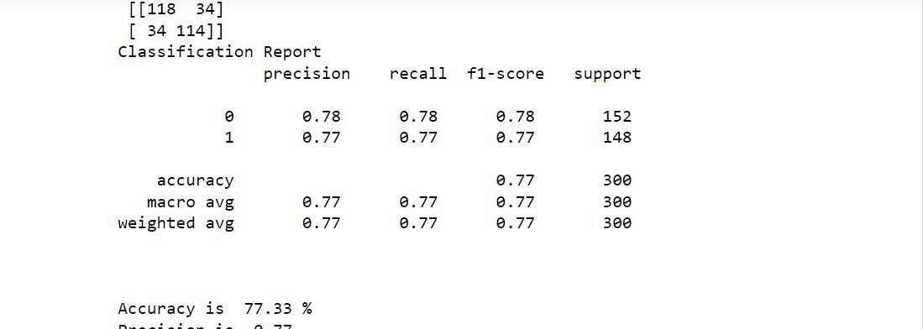
Accuracy score , Classification report and Confusion matrix

Slide 18
Result and Analysis
In this study, an attempt has been made to classify sentiment analysis for restaurant reviews using machine learning techniques. Two algorithms namely Multinomial Naive Bayes and Bernoulli Naive Bayes are implemented.
Evaluation metrics used here are accuracy, precision and recall. Using Multinomial Naive Bayes,
Accuracy of prediction is 77.33%.
From the above results, Multinomial Naive Bayes is slightly better method compared to Bernoulli Naive Bayes and Logistic Regression, with 77.33% accuracy which means the model built for the prediction of sentiment of the restaurant review gives 77.33% right prediction.

Slide 19
Deployment
Customer Section:
Where customer will give text review by selecting food and prediction for review whether it is good or bad is done by using Machine learning and stored the data in Mysql with food items
Owner Login:
Owner can see Stastical analysis of reviews that are stored in database with food and number of customers
We will get Count and percentage plot also the food that has greater than 20 percent negative review and also greater than 40 percent negative

Slide 20
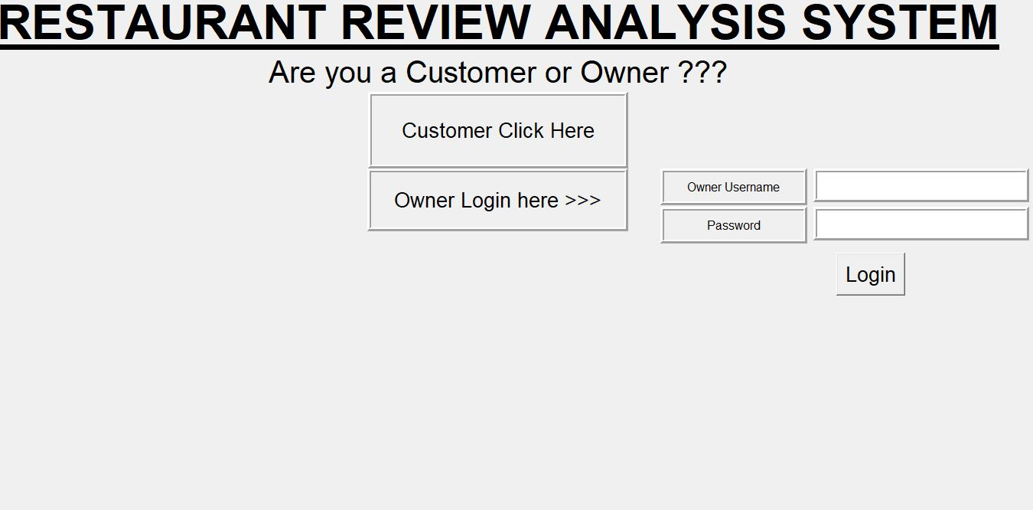

Slide 21
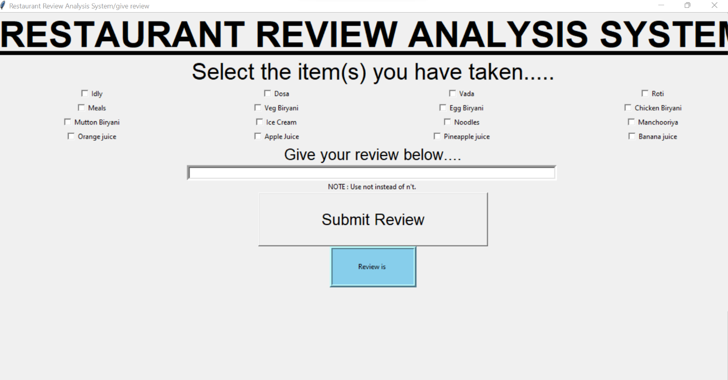

Slide 22
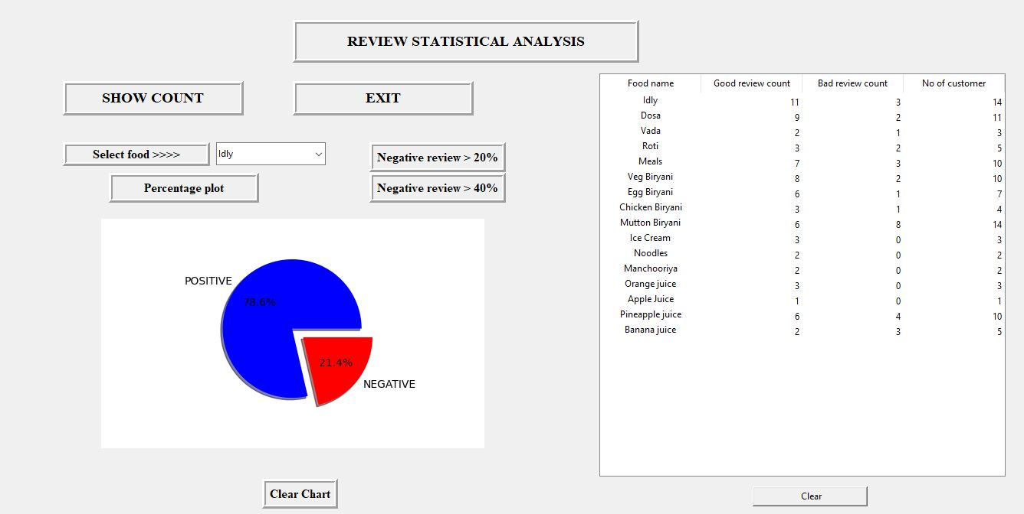

Slide 23
Future Scope
While calculating the sentiment, the sentiment is taken from sentiwordnet3.0, it is for the English language only, we will use different techniques and different libraries like TextBlob to get the sentiment.
This work is done only in the English language, the work can be extended to Indian languages, we have to study more research paper on sentiment analysis on Indian language, and aspect category detection for Indian language , as far as concerned about my knowledge, there are not any sentiwordnet3.0 and Wordnet for Indian language, so we need to implement the work from the scratch. It would be a great

Slide 24
References
‘Sentiment Analysis of Restaurant Customer Reviews on TripAdvisor using Naive Bayes’, 12th International Conference on Information & Communication Technology and System (lCTS) 2019 by Kelly Rossa Sungkono,Riyanarto Sarno
‘Sentiment Analysis of Restaurant Reviews’, International Research Journal of Engineering and Technology (IRJET) Pooja Tyagi Student, Dept. of Computer Science Engineering, Galgotias University, UP, India
Ariyasriwatana, W., Buente, W., Oshiro, M., & Streveler, D. (2014). Categorizing health-related cues to action: using Yelp reviews of restaurants in Hawaii. New Review of Hypermedia and Multimedia, 20(4), 317-340.
Identifying Restaurant Features via Sentiment Analysis on Yelp Reviews Boya Yu, Jiaxu Zhou, Yi Zhang, Yunong Cao Center for Urban Science & Progress New York University New York, NY, the United States
https://github.com/abhi7585/Restaurant-Review-Sentiment-Analysis
https://www.kaggle.com/code/apekshakom/sentiment-analysis-of-restaurant-reviews
https://www.kaggle.com/code/apekshakom/sentiment-analysis-of-restaurant-reviews

